Slide 1

Town of Brookline Select Board Fiscal Year 2026 Tax Classification Hearing November 4, 2025
Prepared by the Board of Assessors

Slide 2
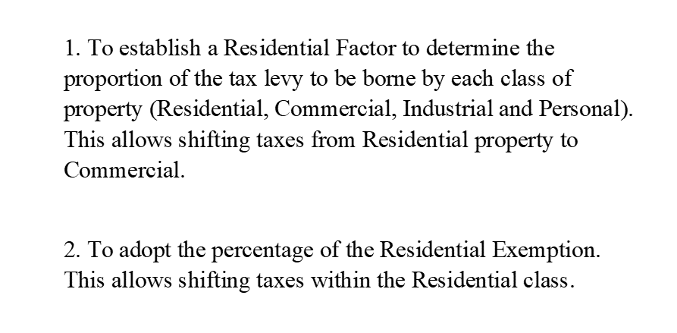
Purpose of the Tax Classification Hearing

Slide 3
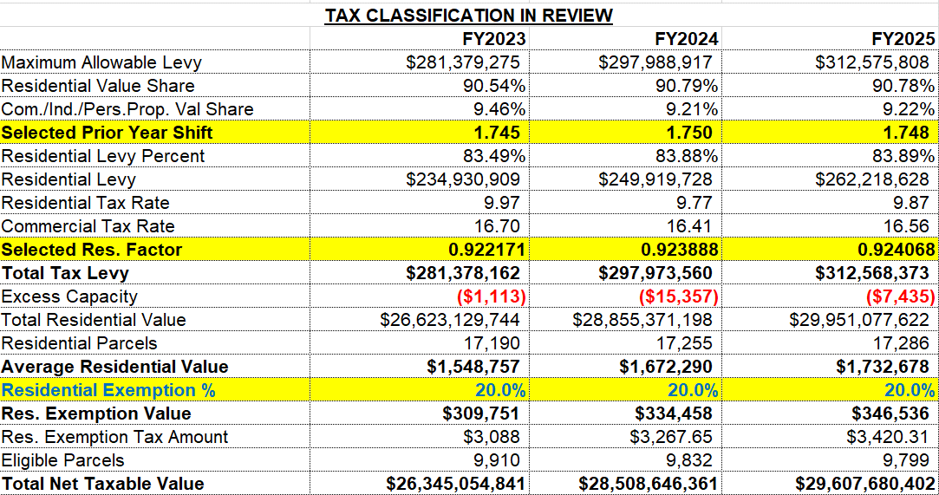

Slide 4
FY2025–FY2026 Value Comparison
Class | FY25 Valuation | FY26 Valuation | Δ
Residential | 29,951,077,622 | 30,758,464,684 | 2.7%
Commercial | 2,609,331,135 | 2,622,051,179 | 0.5%
Industrial | 20,916,000 | 21,561,500 | 3.1%
Personal Property | 410,196,417 | 430,231,850 | 4.9%
Total Value | 32,991,521,174 | 33,832,309,213 | 2.5%
Combined CIP | 3,040,443,552 | 3,073,844,529 | 1.1%
Tax Exempt Real Estate | 3,952,727,853 | 4,082,345,727 | 3.3%

Slide 5
Average Value Change / Class
Use Class | FY26 Parcels | FY26 Value/ Parcel | FY25 Value/ Parcel | Δ
Single Family | 4,579 | 2,844,212 | 2,780,851 | 2.3%
Res. Condo | 10,588 | 977,794 | 950,737 | 2.8%
2 & 3 Family | 1,112 | 2,303,456 | 2,272,113 | 1.4%
Apartments | 361 | 9,183,051 | 8,857,271 | 3.7%
Commercial | 443 | 5,088,879 | 5,018,689 | 1.4%
Industrial | 7 | 3,080,214 | 2,988,000 | 3.1%

Slide 6
FY2026 New Growth
Category | Value Growth | Tax Growth
Single Family Permits | 72,537,200 | 715,942
Res. Condominiums | 43,353,900 | 427,903
Multi-Family.& Apts. | 129,861,335 | 1,281,731
Commercial | 18,007,589 | 298,206
Personal Property | 50,570,310 | 837,444
Total All Classes | 314,330,334 | 3,561,227

Slide 7
FY2026 Tax Levy
Tax Levy | Amount | Percent
FY2025 Levy Limit | $293,111,747
Allowable 2.5% Increase | $7,327,125 | 2.5%
Allowable Net New Growth | $3,534,460 | 1.2%
FY2026 Maximum Levy | $303,973,332
Total FY26 Debt Exclusion | $28,596,862
Total FY2026 Levy | $332,570,194

Slide 8
Residential Exemption FY26?
Total Residential Value = $30,758,464,684/
Total Residential Parcel Count: 17,330 =
Average Residential Value: $1,774,868
Times the selected Exemption Factor: 20% =
Residential Exemption Value: $354,974
Times the selected Residential Tax Rate =
Total Residential Exemption Tax Amount

Slide 9

Residential Exemption Amounts At 20%
Classification | Tax Rate | Tax Amount
Single Tax Rate w/RE (No Shift) | 11.07 | $3,930
1.727% Shift -Residential Rate = | 10.26 | $3,642
1.737% Shift - Residential Rate = | 10.25 | $3,638
1.746% Shift - Residential Rate = | 10.24 | $3,635
Fiscal Year | Exemption Amount
2025 | $3,420
2024 | $3,268
2023 | $3,088
2022 | $3,165

Slide 10
Median Tax Change All Classes W/Res.Ex @20%

Slide 11
Single Family& Condo. w/Res.Ex.(20%)
Med. SFL Value | $2,041,426 | 1.746 | 1.737 | 1.727 | 1.718 | 1.709 | 1.701
Real Estate Tax | (79% RE) | 20,904 | 20,925 | 20,945 | 20,965 | 20,986 | 21,006
Change over FY25 | $19,702 | 1,202 | 1,223 | 1,243 | 1,263 | 1,284 | 1,304
% Increase in Tax |  | 6.1% | 6.2% | 6.3% | 6.4% | 6.5% | 6.6%
Med. Res. Condo | $484,626 | 1.746 | 1.737 | 1.727 | 1.718 | 1.709 | 1.701
Real Estate Tax | (51% RE) | 4,963 | 4,967 | 4,972 | 4,977 | 4,982 | 4,987
Change over FY25 | $4,704 | 259 | 263 | 268 | 273 | 278 | 283
% Increase in Tax |  | 5.5% | 5.6% | 5.7% | 5.8% | 5.9% | 6.0%

Slide 12
Two Fam. & Three Fam. w/Res.Ex. (20%)
Med. Two-Family | $1,849,326 | 1.746 | 1.737 | 1.727 | 1.718 | 1.709 | 1.701
Real Estate Tax | (63% RE) | 18,937 | 18,956 | 18,974 | 18,993 | 19,011 | 19,029
Change over FY25 | $18,056 | 881 | 900 | 918 | 937 | 955 | 974
% Increase in Tax |  | 4.9% | 5.0% | 5.1% | 5.2% | 5.3% | 5.4%
Med. Three-Fam. | $1,990,076 | 1.746 | 1.737 | 1.727 | 1.718 | 1.709 | 1.701
Real Estate Tax | (31% RE) | 20,378 | 20,398 | 20,418 | 20,438 | 20,457 | 20,478
Change over FY25 | $19,395 | 983 | 1,003 | 1,023 | 1,043 | 1,063 | 1,083
% Increase in Tax |  | 5.1% | 5.2% | 5.3% | 5.4% | 5.5% | 5.6%

Slide 13
Apartments & Commercial
Med. Multi-Fam./Apt. | $4,177,950 | 1.746 | 1.737 | 1.727 | 1.718 | 1.709 | 1.701
Real Estate Tax | (4% RE) | 42,782 | 42,823 | 42,865 | 42,907 | 42,949 | 42,991
Change over FY25 | $40,184 | 2,598 | 2,640 | 2,682 | 2,724 | 2,765 | 2,807
% Increase in Tax |  | 6.5% | 6.6% | 6.7% | 6.8% | 6.9% | 7.0%
Med. Commercial | $2,010,200 | 1.746 | 1.737 | 1.727 | 1.718 | 1.709 | 1.701
Real Estate Tax |  | 34,495 | 34,314 | 34,133 | 33,952 | 33,771 | 33,611
Change over FY25 | $33,187 | 1,308 | 1,127 | 946 | 765 | 584 | 424
% Increase in Tax |  | 3.9% | 3.4% | 2.9% | 2.3% | 1.8% | 1.3%
.

Slide 14
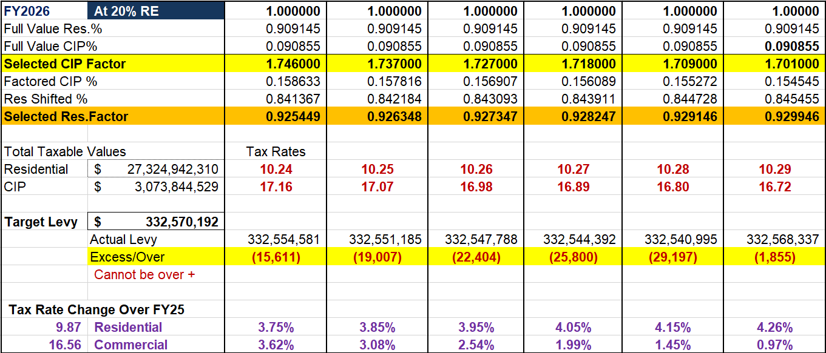
Expanded Tax Rate Worksheet
20% Res. Exemption

Slide 15
Median Tax Change All Classes W/Res.Ex @19%

Slide 16
Single Family& Condo. w/Res.Ex.(19%)
Med. SFL Value | $2,059,175 | 1.743 | 1.733 | 1.724 | 1.715 | 1.706 | 1.697
Real Estate Tax | (79% RE) | 20,962 | 20,983 | 21,004 | 21,024 | 21,045 | 21,065
Change over FY25 | $19,702 | 1,260 | 1,281 | 1,302 | 1,322 | 1,343 | 1,363
% Increase in Tax |  | 6.4% | 6.5% | 6.6% | 6.7% | 6.8% | 6.9%
Med. Res. Condo | $502,375 | 1.743 | 1.733 | 1.724 | 1.715 | 1.706 | 1.697
Real Estate Tax | (51% RE) | 5,114 | 5,119 | 5,124 | 5,129 | 5,134 | 5,139
Change over FY25 | $4,704 | 410 | 415 | 420 | 425 | 430 | 435
% Increase in Tax |  | 8.7% | 8.8% | 8.9% | 9.0% | 9.1% | 9.3%

Slide 17
Two Fam. & Three Fam. w/Res.Ex. (19%)
Med. Two-Family | $1,867,075 | 1.743 | 1.733 | 1.724 | 1.715 | 1.706 | 1.697
Real Estate Tax | (63% RE) | 19,007 | 19,025 | 19,044 | 19,063 | 19,082 | 19,100
Change over FY25 | $18,056 | 951 | 969 | 988 | 1,007 | 1,026 | 1,044
% Increase in Tax |  | 5.3% | 5.4% | 5.5% | 5.6% | 5.7% | 5.8%
Med. Three-Fam. | $2,007,825 | 1.743 | 1.733 | 1.724 | 1.715 | 1.706 | 1.697
Real Estate Tax | (31% RE) | 20,440 | 20,460 | 20,480 | 20,500 | 20,520 | 20,540
Change over FY25 | $19,395 | 1,045 | 1,065 | 1,085 | 1,105 | 1,125 | 1,145
% Increase in Tax |  | 5.4% | 5.5% | 5.6% | 5.7% | 5.8% | 5.9%

Slide 18
Apartments & Commercial
Med. Multi-Fam./Apt. | $4,177,950 | 1.743 | 1.733 | 1.724 | 1.715 | 1.706 | 1.697
Real Estate Tax | (4% RE) | 42,532 | 42,573 | 42,615 | 42,657 | 42,699 | 42,740
Change over FY25 | $40,184 | 2,348 | 2,389 | 2,431 | 2,473 | 2,515 | 2,556
% Increase in Tax |  | 5.8% | 5.9% | 6.0% | 6.2% | 6.3% | 6.4%
Med. Commercial | $2,010,200 | 1.743 | 1.733 | 1.724 | 1.715 | 1.706 | 1.697
Real Estate Tax |  | 34,435 | 34,254 | 34,073 | 33,892 | 33,711 | 33,530
Change over FY25 | $33,187 | 1,248 | 1,067 | 886 | 705 | 524 | 343
% Increase in Tax |  | 3.8% | 3.2% | 2.7% | 2.1% | 1.6% | 1.0%
.

Slide 19
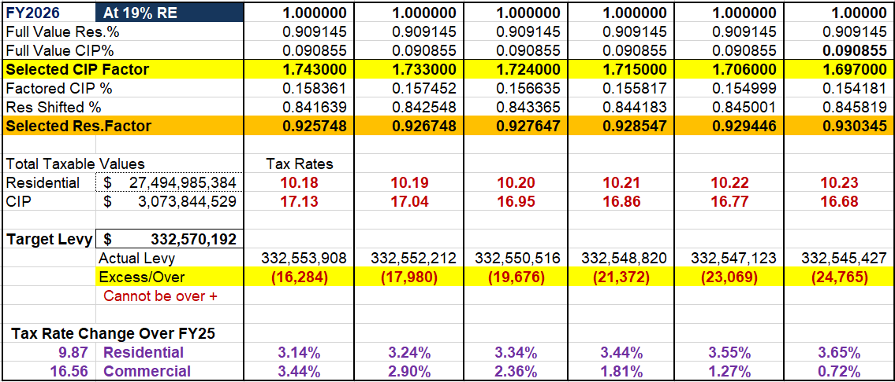
Expanded Tax Rate Worksheet
19% Res. Exemption

Slide 20
Median Tax Change All Classes W/Res.Ex @21%

Slide 21
Single Family& Condo. w/Res.Ex.(21%)
Med. SFL Value | $2,023,678 | 1.749 | 1.741 | 1.731 | 1.722 | 1.713 | 1.704
Real Estate Tax | (79% RE) | 20,844 | 20,864 | 20,884 | 20,905 | 20,925 | 20,945
Change over FY25 | $19,702 | 1,142 | 1,162 | 1,182 | 1,203 | 1,223 | 1,243
% Increase in Tax |  | 5.8% | 5.9% | 6.0% | 6.1% | 6.2% | 6.3%
Med. Res. Condo | $466,878 | 1.749 | 1.741 | 1.731 | 1.722 | 1.713 | 1.704
Real Estate Tax | (51% RE) | 4,809 | 4,814 | 4,818 | 4,823 | 4,828 | 4,832
Change over FY25 | $4,704 | 105 | 110 | 114 | 119 | 124 | 128
% Increase in Tax |  | 2.2% | 2.3% | 2.4% | 2.5% | 2.6% | 2.7%

Slide 22
Two Fam. & Three Fam. w/Res.Ex. (21%)
Med. Two-Family | $1,831,578 | 1.749 | 1.741 | 1.731 | 1.722 | 1.713 | 1.704
Real Estate Tax | (63% RE) | 18,865 | 18,884 | 18,902 | 18,920 | 18,939 | 18,957
Change over FY25 | $18,056 | 809 | 828 | 846 | 864 | 883 | 901
% Increase in Tax |  | 4.5% | 4.6% | 4.7% | 4.8% | 4.9% | 5.0%
Med. Three-Fam. | $1,972,328 | 1.749 | 1.741 | 1.731 | 1.722 | 1.713 | 1.704
Real Estate Tax | (31% RE) | 20,315 | 20,335 | 20,354 | 20,374 | 20,394 | 20,414
Change over FY25 | $19,395 | 920 | 940 | 959 | 979 | 999 | 1,019
% Increase in Tax |  | 4.7% | 4.8% | 4.9% | 5.0% | 5.2% | 5.3%

Slide 23
Apartments & Commercial
Med. Multi-Fam./Apt. | $4,177,950 | 1.749 | 1.741 | 1.731 | 1.722 | 1.713 | 1.704
Real Estate Tax | (4% RE) | 43,033 | 43,075 | 43,116 | 43,158 | 43,200 | 43,242
Change over FY25 | $40,184 | 2,849 | 2,891 | 2,932 | 2,974 | 3,016 | 3,058
% Increase in Tax |  | 7.1% | 7.2% | 7.3% | 7.4% | 7.5% | 7.6%
Med. Commercial | $2,010,200 | 1.749 | 1.741 | 1.731 | 1.722 | 1.713 | 1.704
Real Estate Tax |  | 34,555 | 34,395 | 34,214 | 34,033 | 33,852 | 33,671
Change over FY25 | $33,187 | 1,368 | 1,208 | 1,027 | 846 | 665 | 484
% Increase in Tax |  | 4.1% | 3.6% | 3.1% | 2.5% | 2.0% | 1.5%
.

Slide 24
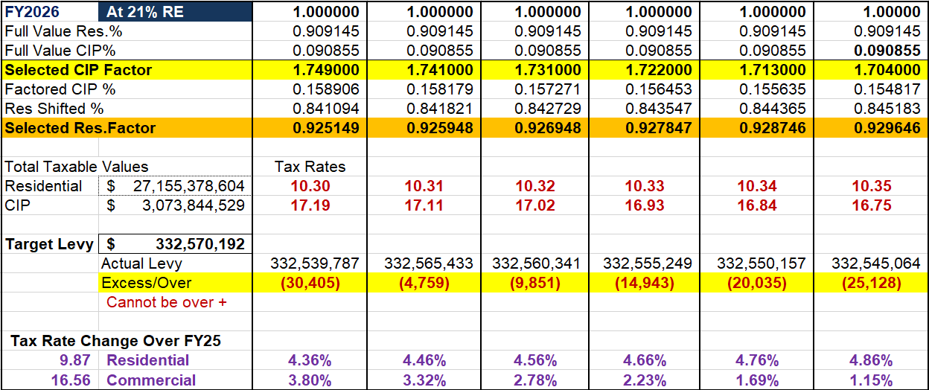
Expanded Tax Rate Worksheet
21% Res. Exemption

Slide 25
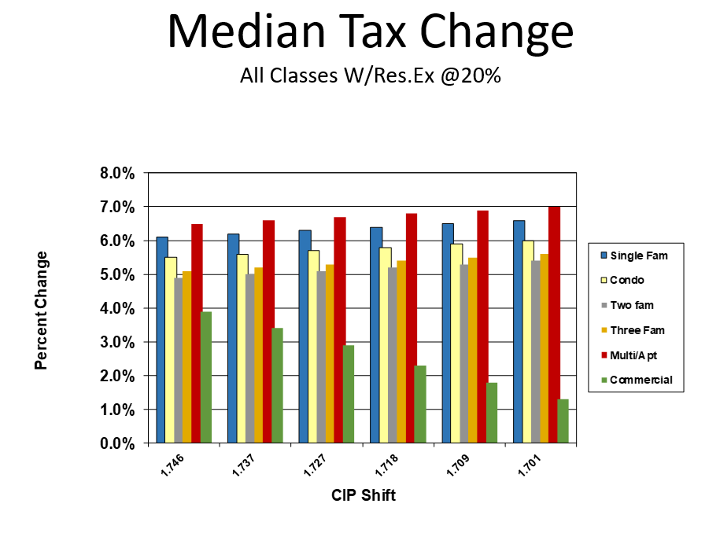
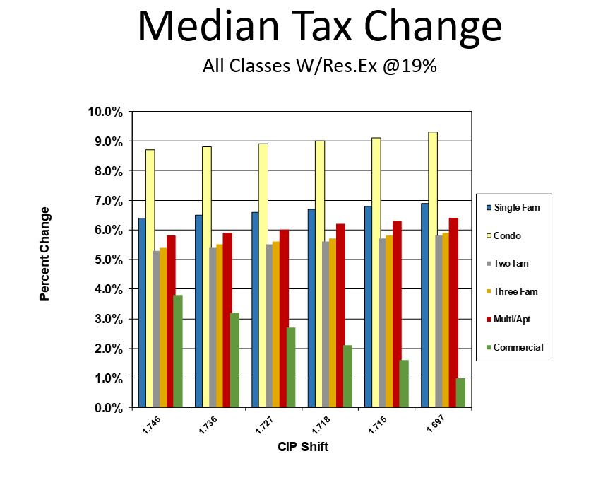

Slide 26
– END OF PRESENTATION –
THE FOLLOWING WORKSHEET SHOWS THE IMPACT
OF THE RESIDENTIAL EXEMPTION AT VARIOUS AMOUNTS

Slide 27
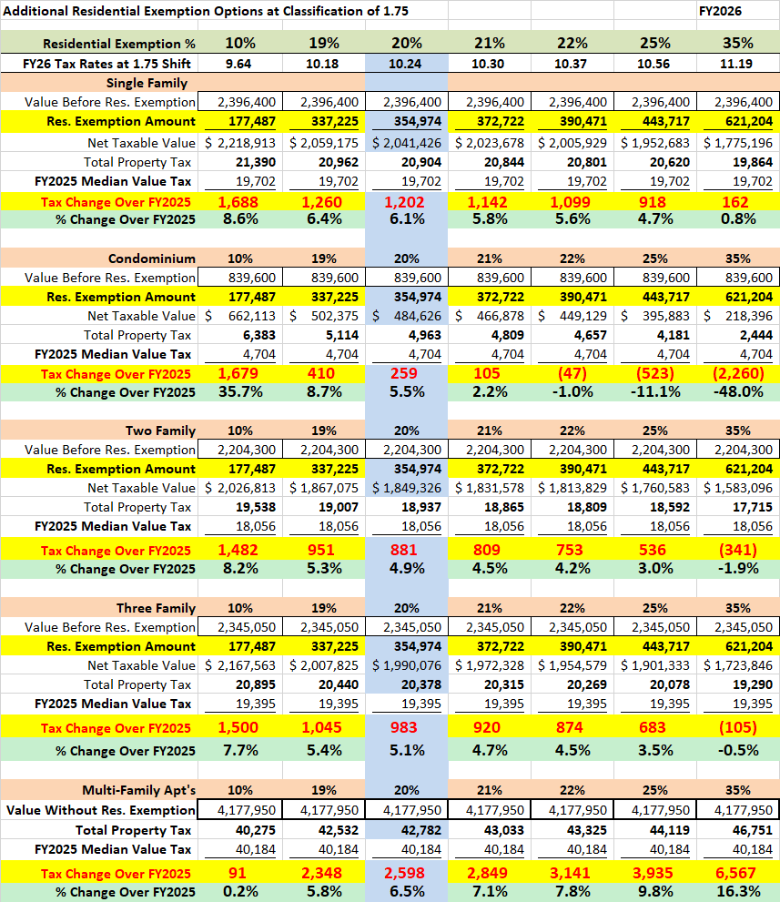

Slide 28
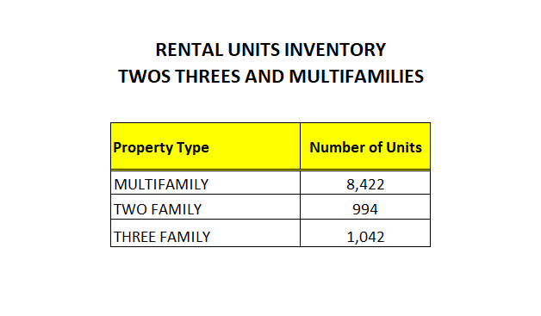
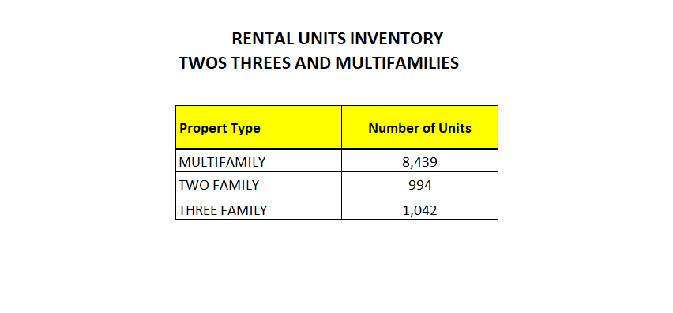

Slide 30
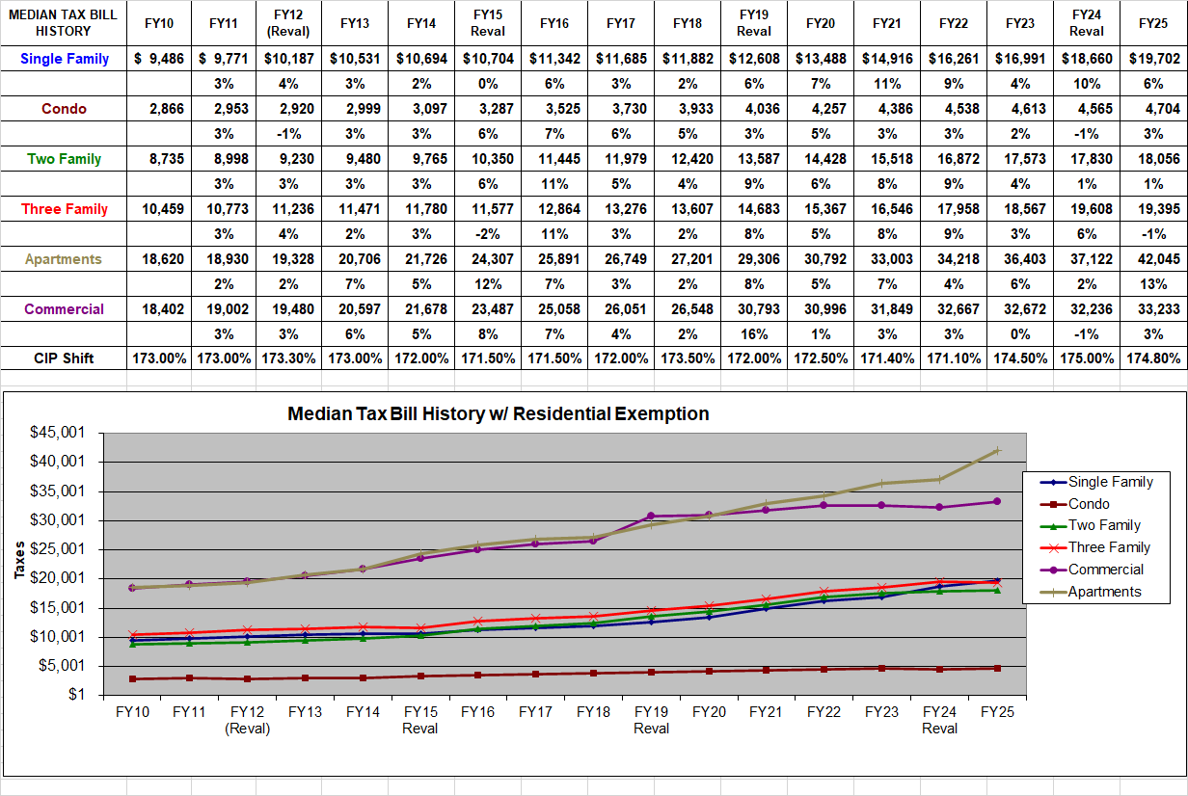

Slide 31
FY26 Value Share By Class

Slide 32
FY25 Value Share By Class

